Slide 1

PRIORITY BASED TRAFFIC MANAGEMENT SYSTEM
GROUP NUMBER - 10
KRISHNANSHU VARSHNEY - 500123186
DEV ASWANI - 500126338
BATCH -1

Slide 2

The Need for Smart Traffic Management
Rapid urbanization has led to increased vehicle density.
Traffic signals do not prioritize emergency vehicles, causing delays.
Manual traffic control is inefficient and error-prone.
Objective: Design a simulation that shows a smart traffic system which:
Automatically prioritizes emergency vehicles
Manages traffic signals dynamically
Improves response time for ambulances and fire trucks

Slide 3
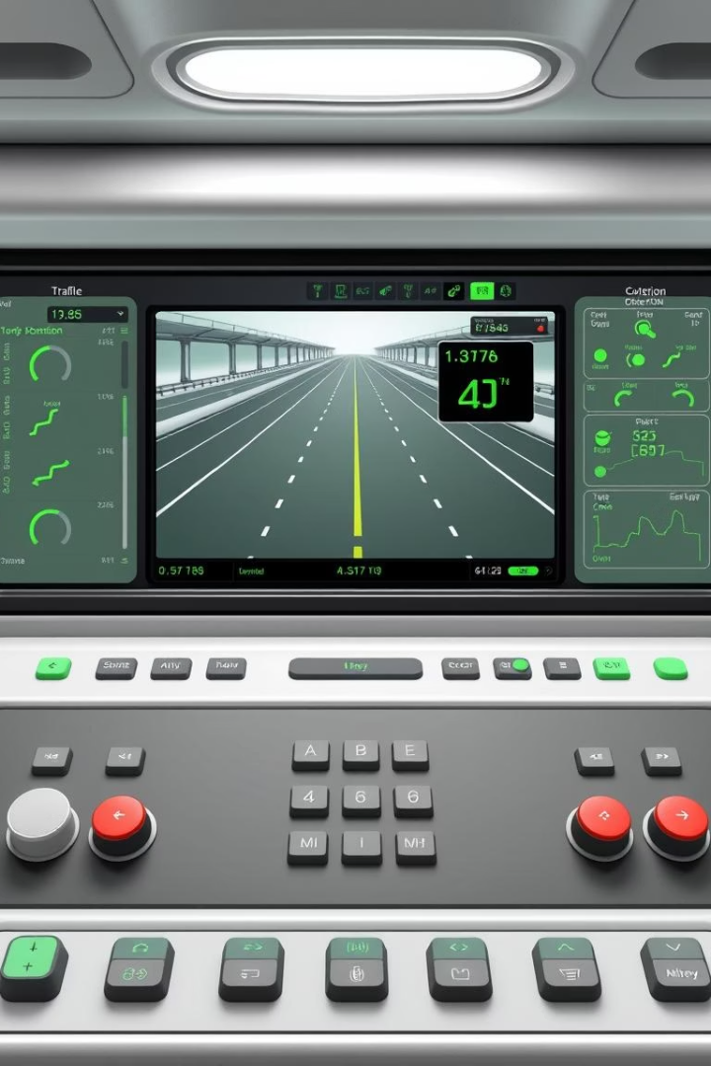

Project Overview
Project Name
Traffic Management System Simulator
Technology Used
Java (Swing), OOPs, Event-Driven Programming
Key Features
Emergency vehicle prioritization
Signal toggling and lane-wise traffic movement
Real-time GUI simulation
User Interactions
Add vehicles (normal/emergency) dynamically
Visual feedback on signal state

Slide 4

Related Work in Smart Traffic Control
Existing Approaches
Limitations
What We Offer
Timer-based signals (static)
Costly real-world implementation
Lightweight simulation model
Camera/RFID-based real-world smart systems
Education-ready prototype
Lack of simulation for educational purposes
Focus on logic, emergency management & UI visualization

Slide 5







System Design (UML)
TrafficSimulator
Main class (JFrame)
RoadPanel
Custom JPanel with simulation logic
Car
Entity class with attributes and movement behavior
Relationships:
TrafficSimulator ➝ contains ➝ RoadPanel
RoadPanel ➝ maintains ➝ List of Car objects for each lane

Slide 6
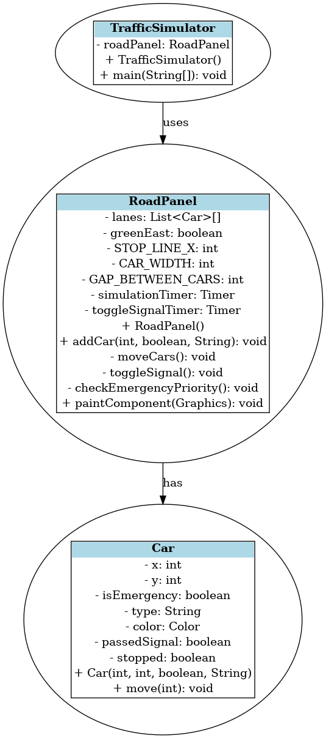





Slide 7
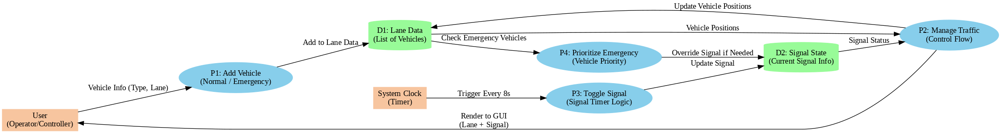



Slide 8
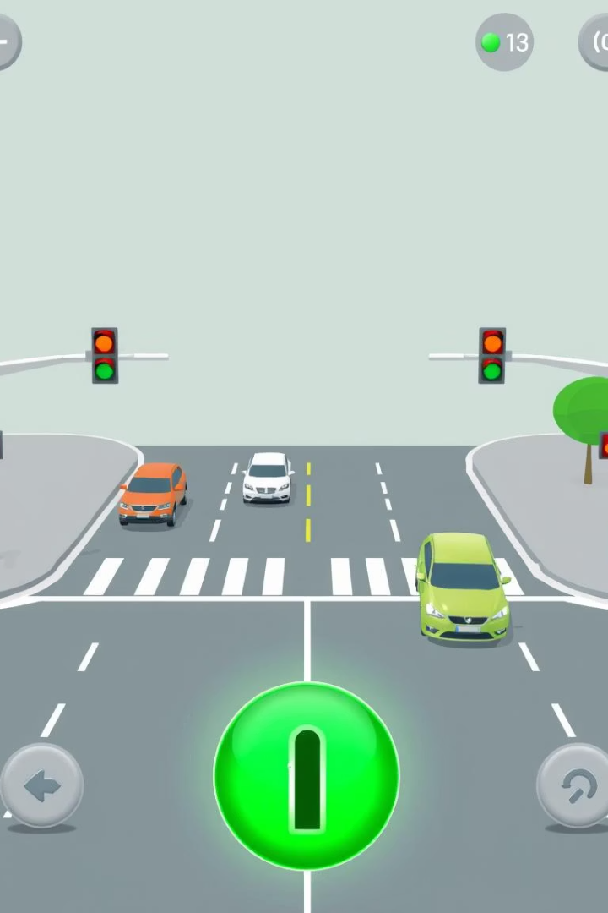






GUI Overview
Tools Used
Java Swing & AWT
Components
Buttons to add vehicles
Dynamic signal visualization (Red/Green)
Real-time car movement across lanes

Slide 9
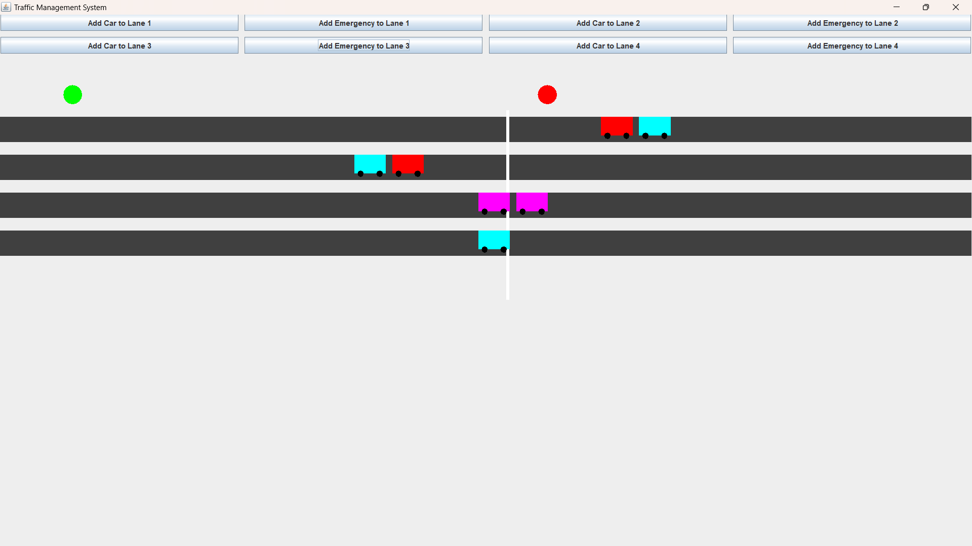
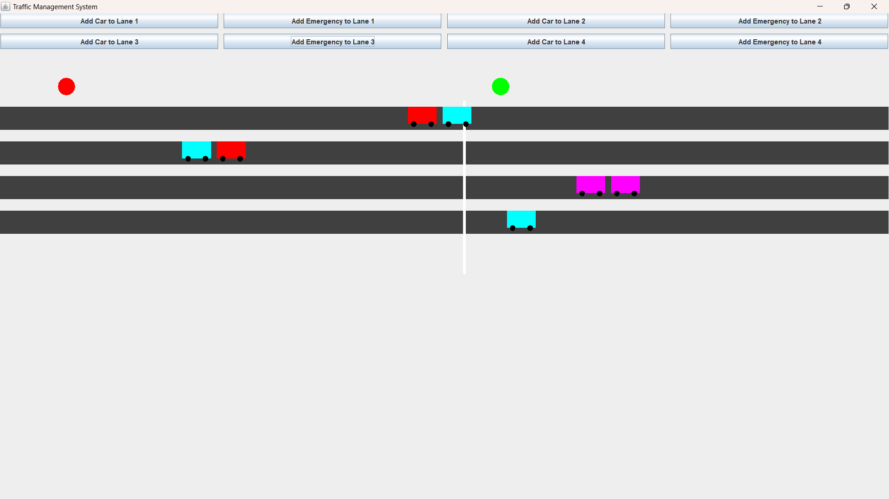

Slide 10









Object-Oriented Design in Action
Encapsulation
Polymorphism
Car class encapsulates car properties & behavior
Emergency vs Normal car behavior at signal
Java Swing
Abstraction
ActionListeners for button inputs
RoadPanel hides movement & rendering logic
Timers for animation and logic flow

Slide 11




Results of the Simulation
Emergency Vehicle Priority
Emergency vehicles bypass traffic with signal priority
Automatic Signal Control
Traffic signal toggles automatically
Realistic Movement
Vehicles move realistically within constraints
Efficiency Highlights:
Smooth GUI experience
Real-time decision-making simulation

Slide 12




Summary & Future Scope
Future Scope
Advanced features and integrations
Successful Implementation
Core objectives achieved
Technical Foundation
OOP and Swing implementation
Key Points:
Effective use of OOP and Swing for simulation
Practical representation of smart traffic logic
Emergency vehicle prioritization implemented successfully
Future Scope:
Add database for traffic logs
Integrate sensors and AI-based prediction models
Convert into mobile app or IoT prototype

